Slide 1
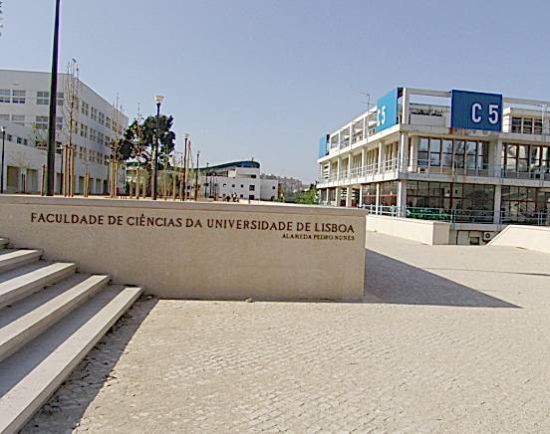
Communication & Image
at Ciências ULisboa
New Professors & Researchers Welcome Workshop
September 6, 2023
Marta Daniela Santos
Pedro Almeida
SubDirector for Communications
& External Image
Communication & Image Unit,
Ciências ULisboa
Notes:
What I hope to convey to you with this talk:
- persuade you of the importance of communicating your research, and how we at Ciências ULisboa can support you in doing so
- share with you our general communication guidelines, although in a very broad scope, as we have a short period of time
- highlight to you our main institutional and outreach events and why we encourage you to actively collaborate with us on them
OUR VOICE:
- EMPATHIC: people should empathize with what we do
- TRUSTWORTHY: we communicate based strictly on scientific knowledge
- SOCIALLY RELEVANT: we engage in projects aiming for a better world.

Slide 2
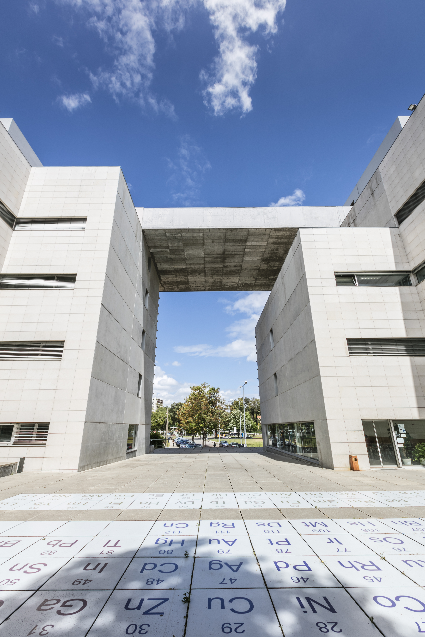
Ciências ULisboa voice
Empathic
Trustworthy
Socially relevant
Notes:
- EMPATHIC: people should empathize with what we do
- TRUSTWORTHY: we communicate based strictly on scientific knowledge
- SOCIALLY RELEVANT: we engage in projects aiming for a better world.

Slide 3
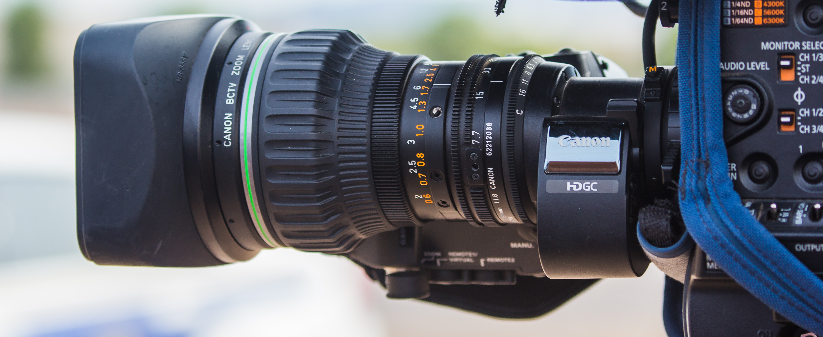
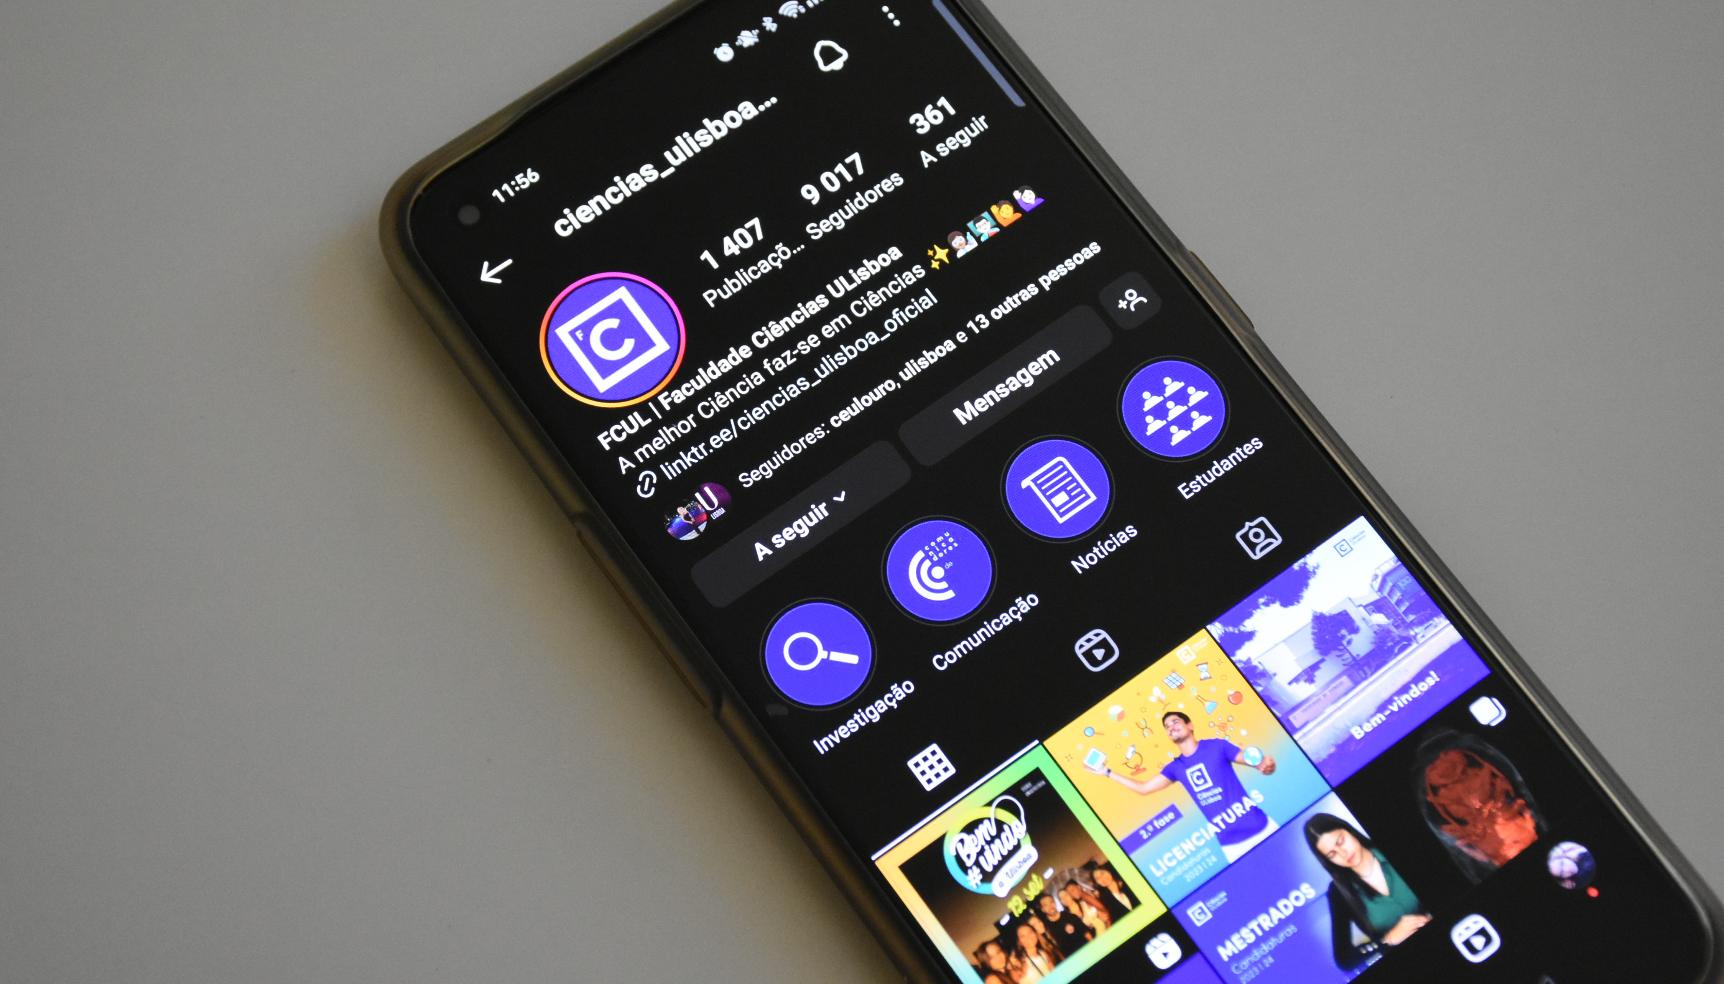

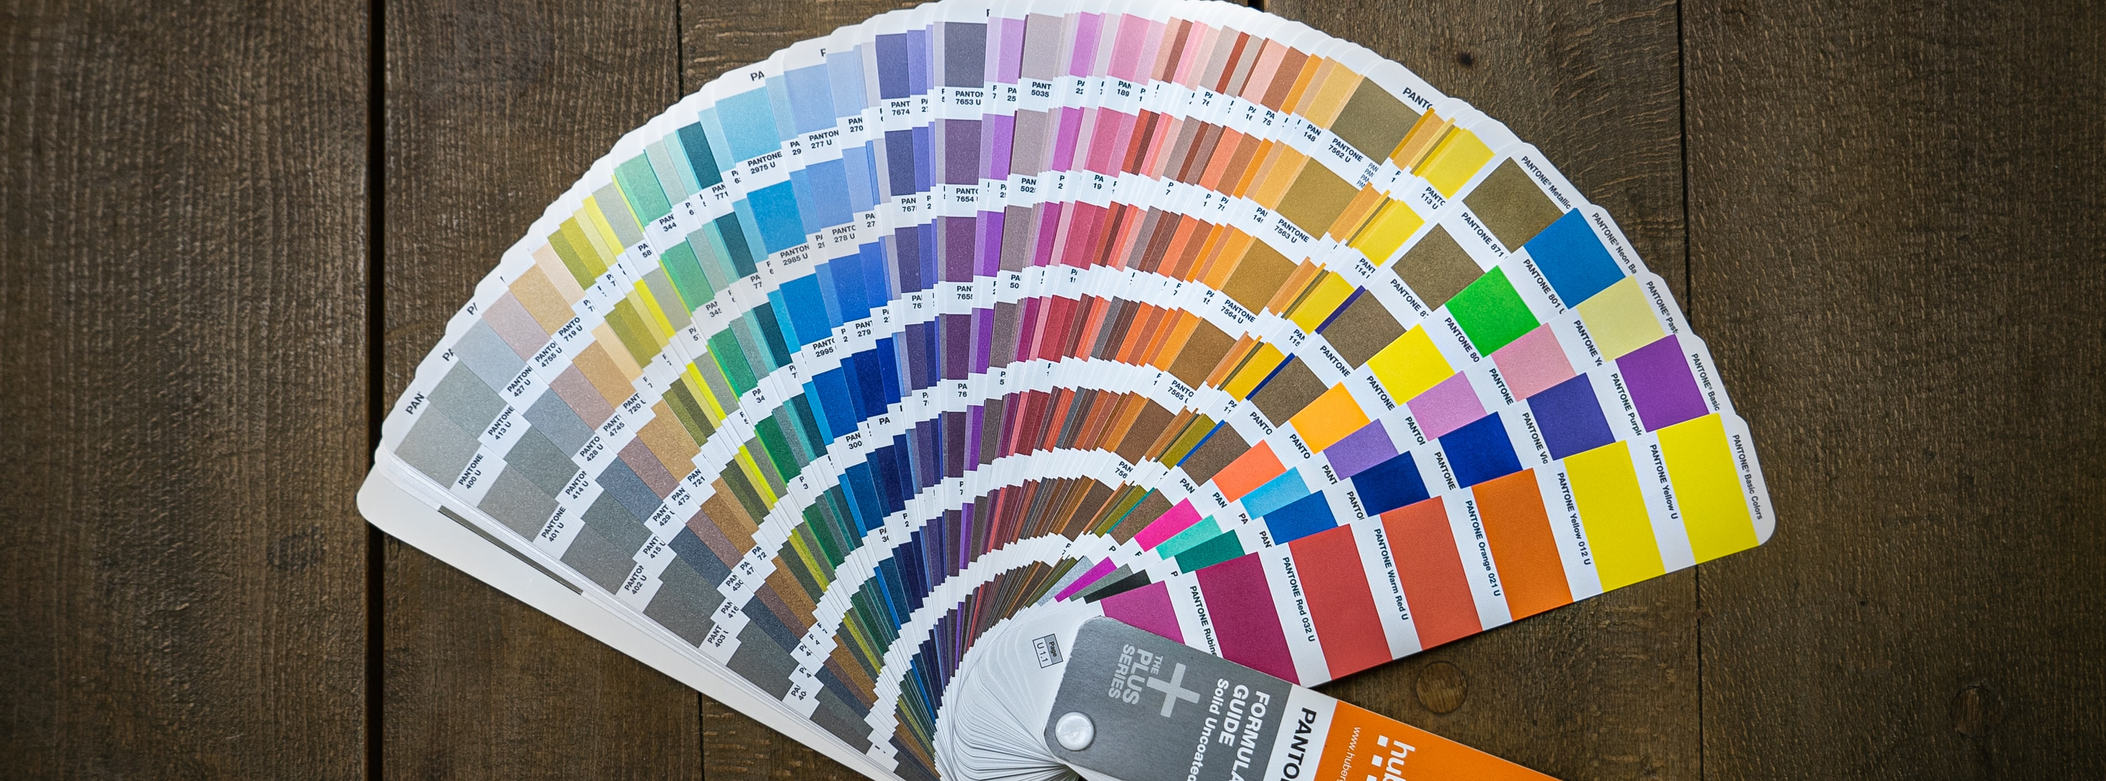
Notes:
What can we do for you, and with you?
- Press releases / news
- promote your work through social media
- clipping: press kit and science experts
- graphical works and design
- support you in the correct use of the Ciências visual identity and brand
- produce vídeos and reports
- LCDs and exhibitions

Slide 4



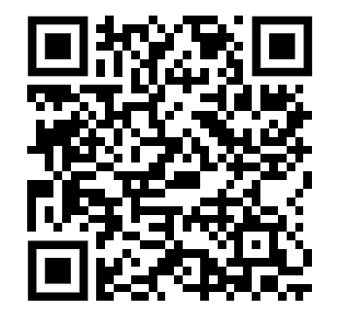
Ciências Visual Identity
E-mail signatures
Visual Identity and Graphic Standards
Mr/Ms X or Y
Professor/Researcher…
Departament / R&D Unit
Faculdade de Ciências da Universidade de Lisboa
Campo Grande 1749-016 Lisboa · Portugal
T (+351) 217 500 000 • Ext. ????? www.ciencias.ulisboa.pt
Find our Visual Identity & Graphics Standards HERE, after logging in at
Ciências ULisboa website:
Notes:
The Faculty’s logo:
// Is the official graphic mean for public recognition of Ciências.
// Is directly associated to the “brand” Ciências Ulisboa.
IT MUST BE USED:
in all official presentation using the Ciências affiliation.
on websites approved by Ciências –
IT MUST NOT BE USED:
for personal purposes (for example in personal sites or associated to personal opinions)
On our website, after you’ve made login with your e-mail and password, you can access our Visual Identi,ty and Graphic Standards, in which you find info about creating websites for Departments, courses, R&D units, about how you can promote the Faculty on the web, instructions on how to Setup your e-mail signatures, among other importante aspects. Once you’ve made login, you also have access on this page to our Graphic Standards Manual, which includes valuable information about how our logo can be used.
If you have any doubts, you can contact us – Communication & Image Unit – at any time. I will share with you our contact at the end of this presentation.

Slide 5
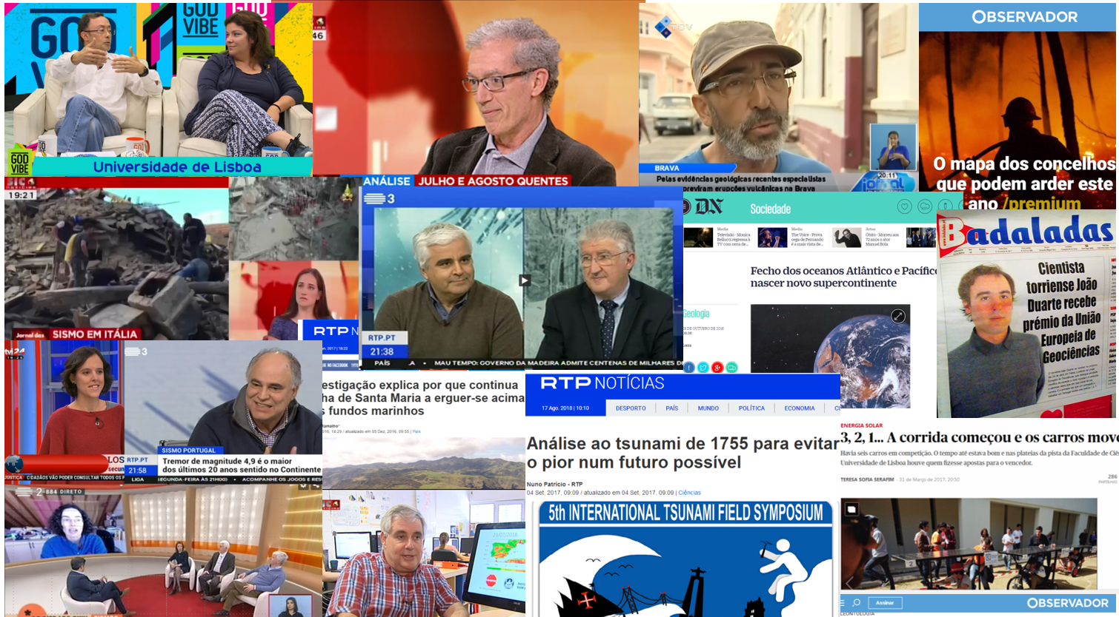
Notes:
Please do not be afraid of talking with journalists:
Having the opportunity to discuss your work with journalists can give you access to a very broad audience, that you would not be able to access in other ways.

Slide 6

Where: news, newsletter & social media
In 2022:
4596 mentions on news media
154 journalistic genres published
31 press releases sent to the media
52 issues of our newsletter sent
Notes:
Don't be afraid of journalists they need us to do their job and we need them to communicate what we do to the world.
Whenever you have any meaningful result or activity ask for your help
ASPECTS TO MENTION:
- NEWSLETTER: The most important aspects of Ciências life are weekly digested into the Ciências Newsletter – of crucial consultation to keep being informed and share your ativities within and outside Ciências.You can subscribe to the Ciências newsletter directly on our website .
ABOUT NEWS:
News production; Selection of topics for news treatment. Writing, editing and dissemination of briefs, reports, interviews, chronicles, opinion articles, photo subtitles and photo reports. Review of opinion articles and news content.
PRESS KIT CIÊNCIAS ULISBOA AND EXPERTS KIT: The Press Kit Sciences ULisboa provides Media access, among other information, to the names of several members of the Faculty, specialists in a range of cutting-edge scientific subjects.
We kindly ask you that, whenever you need our support for producing news, or supporting events that you are organizing, communicate with us as soon as possible, plenty of time in advance whenever possible. We request this so we can coordinate with with other requests, and plan our calendar accordingly.
Besides requests from researchers, which we are glad to support, we are also responsible for institutional and outreach events during the whole academic year – more about this in a few minutes – so we need to validate and organize our timetable with time in advance.

Slide 7





Where: news, newsletter & social media
In 2022:
4596 mentions on news media
154 journalistic genres published
31 press releases sent to the media
52 issues of our newsletter sent
Furthermore:
Press kit and science experts
Clipping service
Thousands of followers on
Notes:
ASPECTS TO MENTION:
- NEWSLETTER: The most important aspects of Ciências life are weekly digested into the Ciências Newsletter – of crucial consultation to keep being informed and share your ativities within and outside Ciências.You can subscribe to the Ciências newsletter directly on our website .
ABOUT NEWS:
News production; Selection of topics for news treatment. Writing, editing and dissemination of briefs, reports, interviews, chronicles, opinion articles, photo subtitles and photo reports. Review of opinion articles and news content.
PRESS KIT CIÊNCIAS ULISBOA AND EXPERTS KIT: The Press Kit Sciences ULisboa provides Media access, among other information, to the names of several members of the Faculty, specialists in a range of cutting-edge scientific subjects.
We kindly ask you that, whenever you need our support for producing news, or supporting events that you are organizing, communicate with us as soon as possible, plenty of time in advance whenever possible. We request this so we can coordinate with with other requests, and plan our calendar accordingly.
Besides requests from researchers, which we are glad to support, we are also responsible for institutional and outreach events during the whole academic year – more about this in a few minutes – so we need to validate and organize our timetable with time in advance.

Slide 8
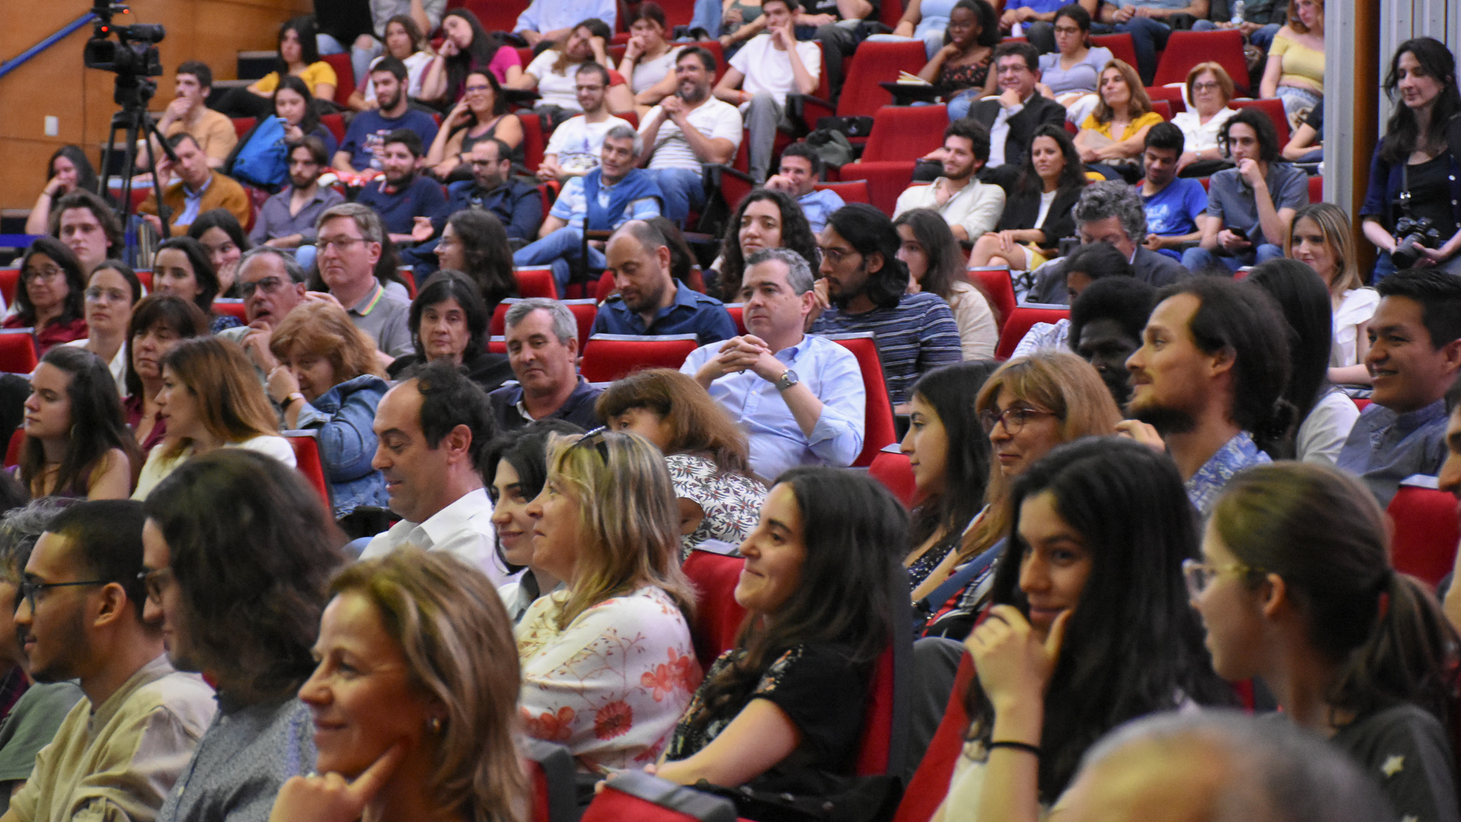

Slide 9
When: main institutional events
New Students Welcome Session: September 18, 2023
Ciências Research & Innovation Day: October 24, 2023
Dia de Ciências: April 23, 2024
Ciências Jobshop: May 2024
Notes:
New Students Welcome Session: September 18, 2023
Ciências Research & Innovation Day: October 24, 2023
A public showcase of the best science produced at this centenary institution.
Not only we have a full day of invited talks at our Main Auditorium of Ciências ULisboa (C3 Building), but we also have a poster session - a valuable networking opportunity which can allow you to forge relationships for future collaborations.
This year we are planning on some updates – the first one already in the name of the event, which also explicitely mentions Innovation, as well as on the span of the side events that we already organize, such as lab visits, speed dating between scientists, debates and conversations involving students as well, and so on.
How can you be involved? On the one hand, a cal for submitting posters will be sent to the research units. Furthermore, you can submit your proposal for a side event – the cal will be announced shortly (we are working on the final details). Last but not least, please encourage your students to attend, as this is na invaluable opportunity for them – as well as you! – to learn more about the research that is being done at the Faculty in its diverse scientific áreas.
DIA DE CIÊNCIAS 2024: APRIL 23, 2024
On April 19, 2024, we will celebrate the anniversary 113 of Ciências ULisboa.
After the already traditional message of the Director, the program will highlight distinctions for Ciências ULisboa students and staff, and surprise elements that will guide the session until the expected performance of VicenTuna and the birthday cake.
On this day there is usually exemption from classes during the ceremony.
Ciências Jobshop:
It is the job fair of the Faculty of Sciences of the University of Lisbon, organized annually by the Employability Office and the Student Association of the Faculty of Sciences of Lisbon (AEFCL).
This event aims to bring students/recent graduates from various Science courses closer to the job market, through workshops, interviews and contact with companies and recruiters.

Slide 10
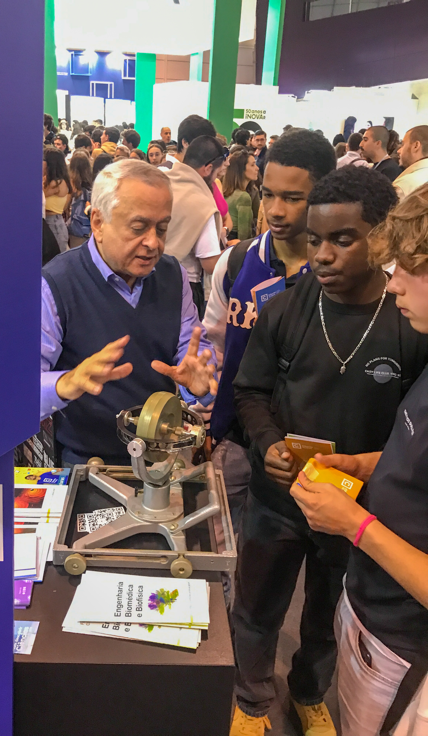
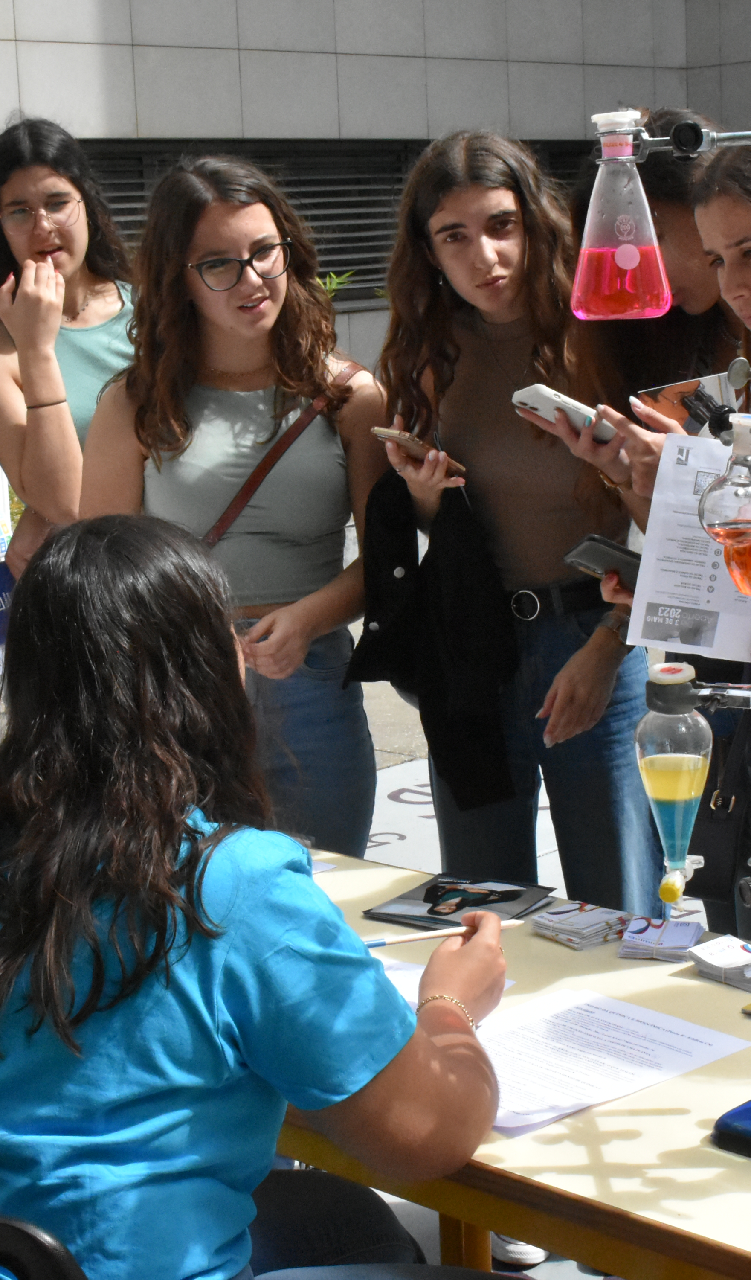
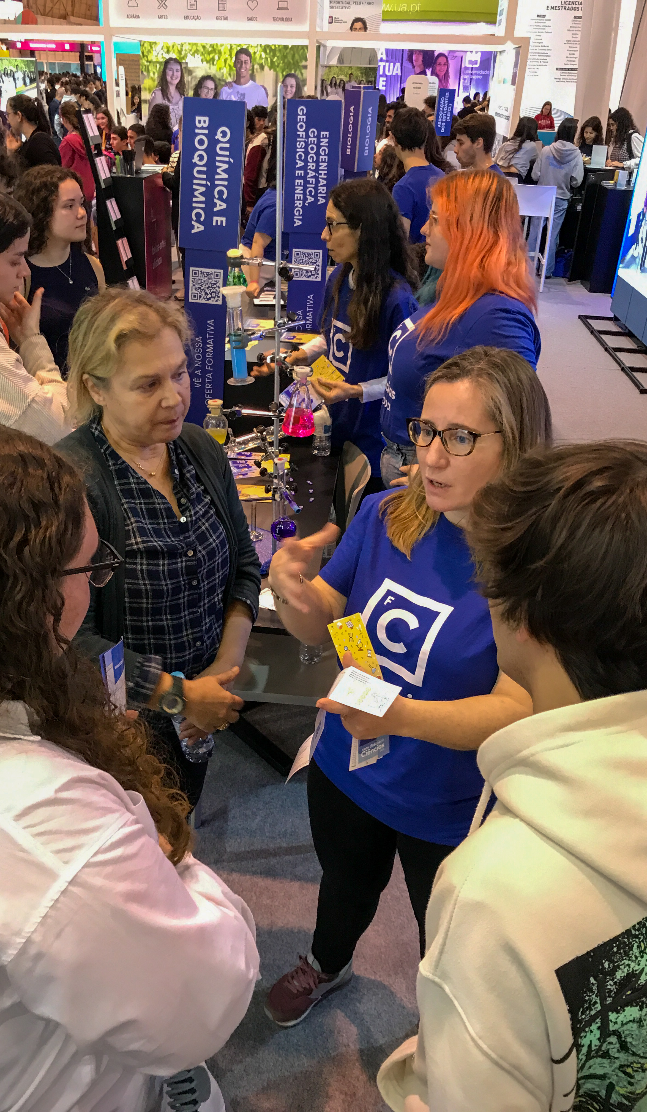

Slide 11
When: main outreach events
European Researchers’ Night: September 29, 2023
Visits to schools and from schools: during all academic year
Futurália: March 20-23, 2024
Ser Cientista: last week of July 2024
And our Ciências Open Days:
Bachelor’s Degrees: first week of May 2024
Master’s Degrees: May 2024
Notes:
OUTREACH EVENTS: aimed at schools and a general audience
EUROPEAN RESEARCHERS’ NIGHT:
Bring research and researchers closer to the public, and increase the interest of young people in science and research careers.
Showcase the impact of researchers’ work on people’s daily lives
FUTURÁLIA: 20-23 march 2024
Futurália is the largest education and training fair held in Portugal, attracting thousands of students, teachers and families every year. In 2023, Futurália welcomed about 65 000 visitors, with almost 400 school visits. Being at Futurália is indeed an experience on its own, and a prime opportunity to chat with high school students.
CIÊNCIAS OPEN DAYS:
SER CIENTISTA: last wek of July.
Welcoming secondary school students in daily live of research projects with direct engagement of Ciências scientists

Slide 12
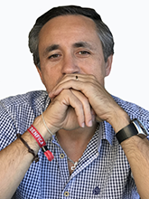
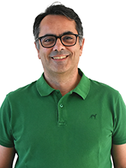
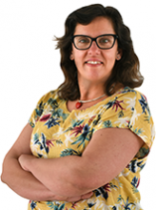
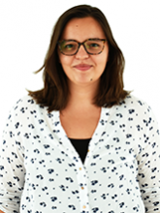
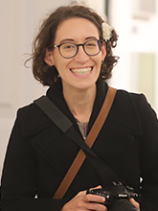
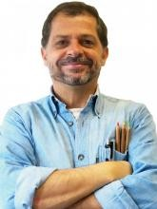
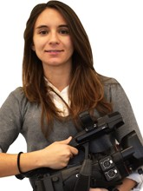
Who is who in the Communication & Image Unit?
Academic Marketing Area
Journalism Office
Science Communication Office
Subdirector for Communications and External Relations
Image & Digital Content Office

Slide 13
How to reach us:
Building C5, 3rd Floor
Ext. 525 381 / 525 341
E-mails:
For general information:
aci@ciencias.ulisboa.pt
For news and newsletter:
info.ciencias@ciencias.ulisboa.pt
Office Hours (weekdays)
10h00-12h30 / 14h00-17h00

Slide 14
Thank you!
Communication & Image Unit
aci@ciencias.ulisboa.pt

