Slide 2
Júlia Alves
Technical Support Unit + Emergency operations manager
jmaalves@ciencias.ulisboa.pt; Room 4.1.28, Int. 524126, Tlm. (+351) 914957401
Filipa Pegarinhos
Safety, Health and Sustainability Office coordinator
g3s@ciencias.ulisboa.pt; Room 4.1.26, Int. 524127, Tlm. (+351) 964730364
www.ciencias.ulisboa.pt/g3s | g3s@ciencias.ulisboa.pt

Slide 3
www.ciencias.ulisboa.pt/g3s | g3s@ciencias.ulisboa.pt

Slide 4
EVACUATION procedures
Immediately leave the building after an evacuation alarm
Follow exit signs and evacuation routes
Follow emergency personnel instructions
Do not use the lifts
Do not go back into the building
Walk fast and orderly to the assembly point
www.ciencias.ulisboa.pt/g3s | g3s@ciencias.ulisboa.pt

Slide 5
Safety
Good laboratory practices
Hazard identification and risk evaluation
Occupational risk assessment
Automatic fire detection systems
Plans and procedures
Safety reports
Fire protection of buildings
Building evacuation
Safety drills
First aid
Fire safety
Hazardous substances
Emergency management
Certified training for emergency staff
Health and safety short courses
Information, instructions and safety courses
www.ciencias.ulisboa.pt/g3s | g3s@ciencias.ulisboa.pt

Slide 6
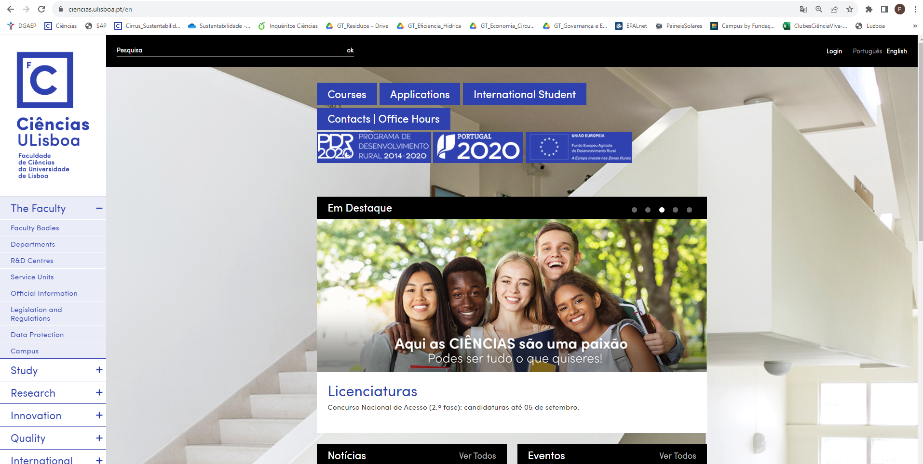
www.ciencias.ulisboa.pt/g3s | g3s@ciencias.ulisboa.pt

Slide 7
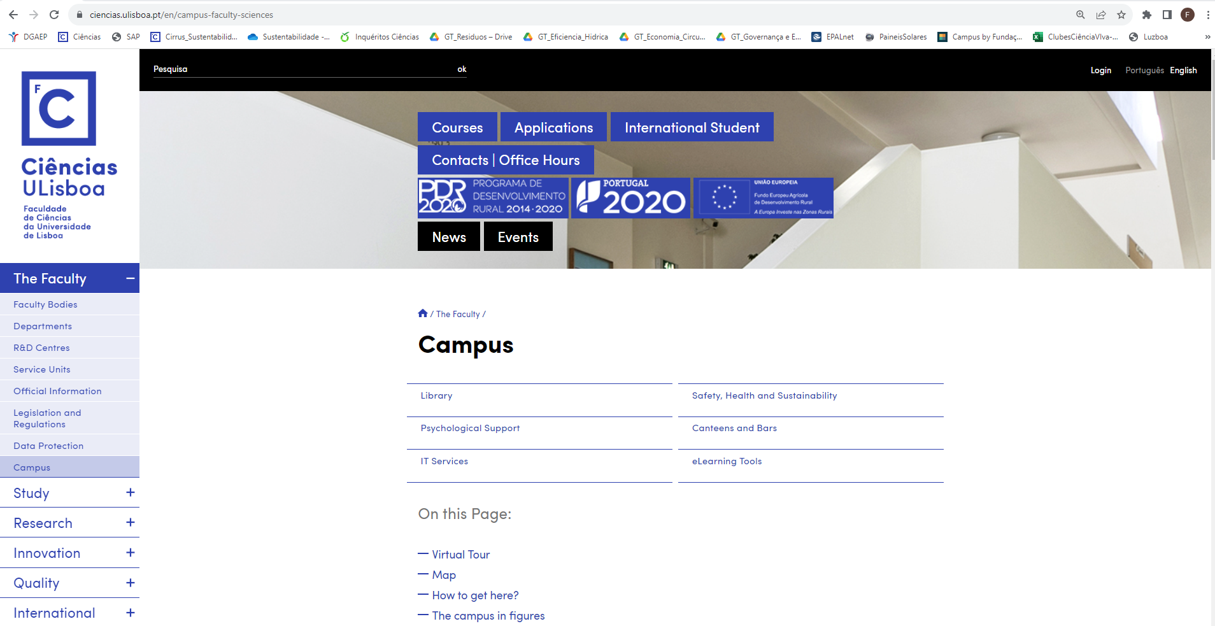
www.ciencias.ulisboa.pt/g3s | g3s@ciencias.ulisboa.pt

Slide 8
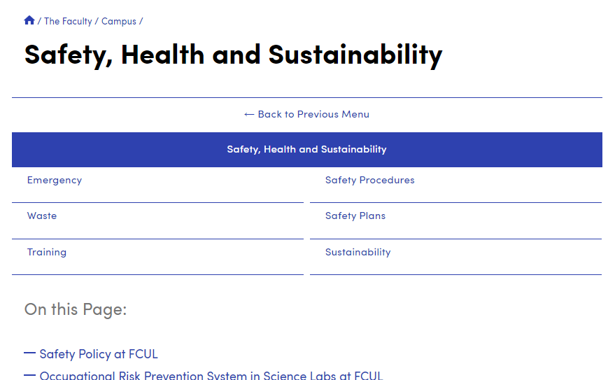
www.ciencias.ulisboa.pt/g3s | g3s@ciencias.ulisboa.pt

Slide 9
General Laboratory Safety Rules
Order D/16/2022 (11/03/2022)
in advance, know all the risks and prevention measures
consult the Safety Data Sheets (SDS)
do not smoke, eat, drink or store food in the laboratory
wear appropriate clothing, footwear and Individual Protection Equipment (IPE)
while wearing contaminated gloves, do not use mobile phones or touch lift buttons and door handles
www.ciencias.ulisboa.pt/g3s | g3s@ciencias.ulisboa.pt

Slide 10
identify all containers. Minimize the amount of reagents stored in the laboratory
Never dispose hazardous waste in the dustbin or sink
keep the workbench clean and tidy
know the location and usage of the emergency equipment
clear access to evacuation routes, emergency exits and emergency equipment
clearly hear alarms
do not wear lab coats outside of the laboratory
www.ciencias.ulisboa.pt/g3s | g3s@ciencias.ulisboa.pt

Slide 11
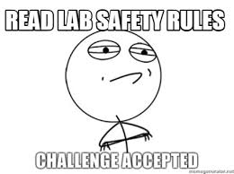
wash your hands before leaving the laboratory
in case of emergency: Stay calm, call ext. 20000 or +351 217 500 600, identify the type and location of the occurrence (building, floor and room). Put yourself in safety until the arrival of the emergency team providing all the information about the occurrence.
www.ciencias.ulisboa.pt/g3s | g3s@ciencias.ulisboa.pt

Slide 12
Health
Promoting Health at work
Health surveillance and health examinations
Occupational Health Service
Accidents at work
Emergency @ Ciências (Ext. 20000 | +351 217 500 600)
Accidents at work must be reported to the Human Resources Unit
www.ciencias.ulisboa.pt/g3s | g3s@ciencias.ulisboa.pt

Slide 13
Sustainability
Sustainability Living Lab
www.ciencias.ulisboa.pt/g3s | g3s@ciencias.ulisboa.pt

Slide 14
Sustainability Living Lab @ Ciências ULisboa aims to:
Give coherence and visibility to a diverse set of activities already going on
Enhance the involvement of the school´s community, and the surrounding reality
Promote good practices for sustainability on the school campus, hosting, monitoring and experimentation projects in all aspects of sustainability (social, , environmental and economic)
www.ciencias.ulisboa.pt/g3s | g3s@ciencias.ulisboa.pt

Slide 15
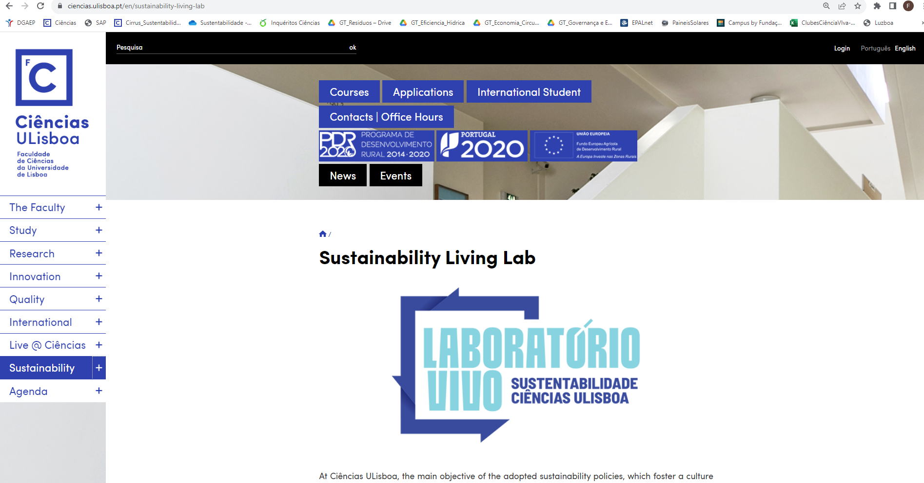
www.ciencias.ulisboa.pt/g3s | g3s@ciencias.ulisboa.pt

Slide 16
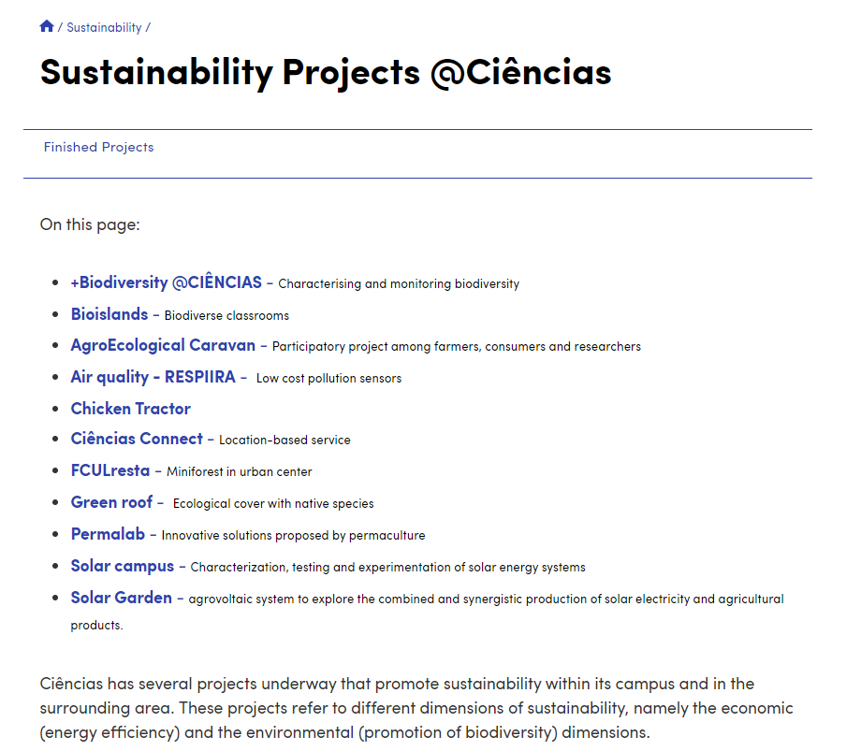
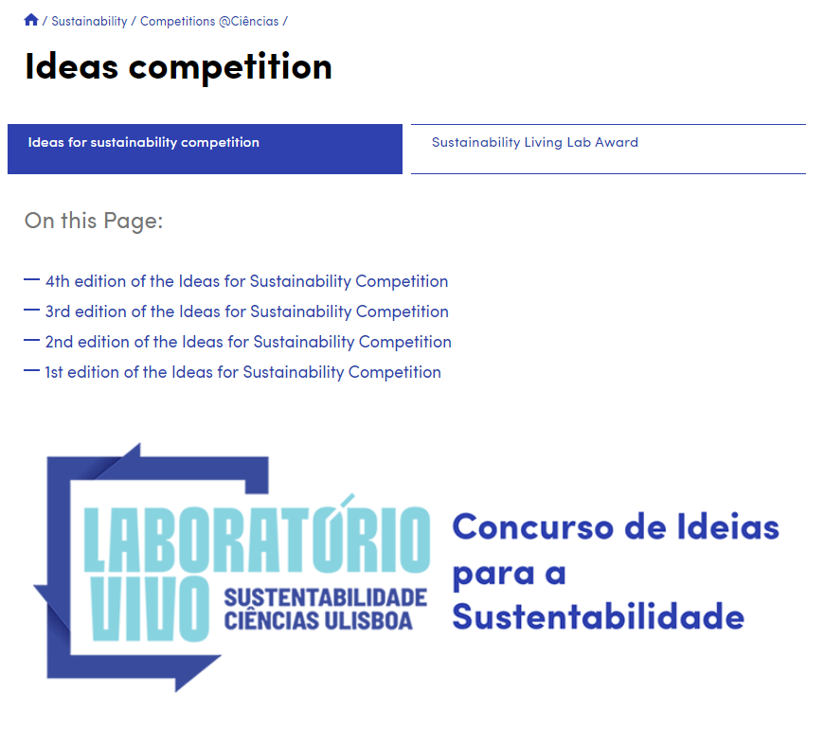
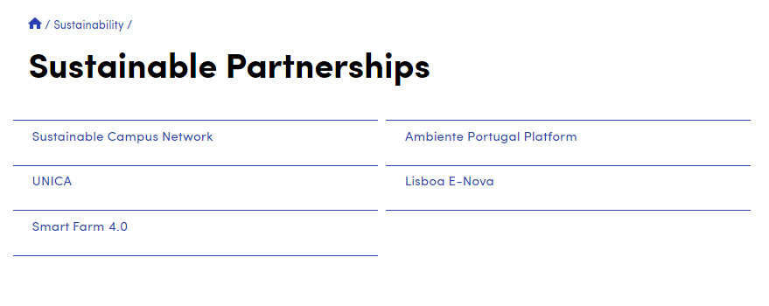
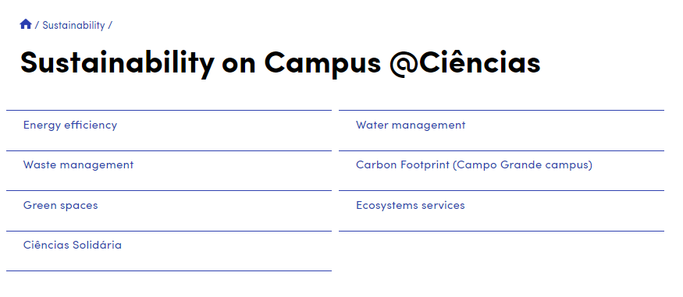
Explore the Campus and get involved in existing projects:
www.ciencias.ulisboa.pt/g3s | g3s@ciencias.ulisboa.pt

Slide 17
Adopt good sustainability practices:
Energy
use the stairs
wear clothing appropriate to the season
turn off air conditioners and heaters if weather conditions permit
benefit from natural light
turn off lights and appliances when you leave the room
avoid or reduce paper prints
Water
promote responsible use
do not let water run unnecessarily
report faults in faucets and/or plumbing
www.ciencias.ulisboa.pt/g3s | g3s@ciencias.ulisboa.pt

Slide 18
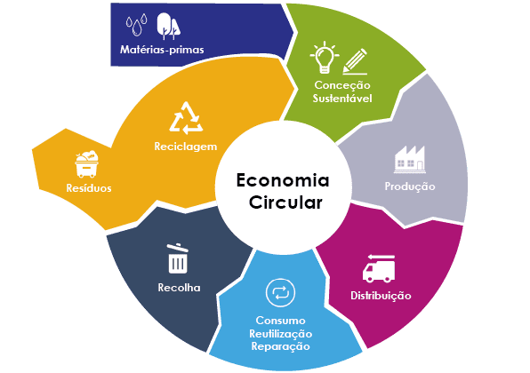
Adopt good sustainability practices:
Waste, Materials and
Circular Economy
reuse as possible
separate for recycling
forward organic waste for composting
use reusable cups and bottles
reuse materials
Mobility and Transport
avoid unnecessary trips
prefer walking, cycling or public transport
share car
www.ciencias.ulisboa.pt/g3s | g3s@ciencias.ulisboa.pt

Slide 19
Important contacts
Emergency contacts:
Ext. 20000; Dir (+351) 217 500 600
Safety, Health and Sustainability Office (general):
g3s@ciencias.ulisboa.pt
Sustainability:
sustentabilidade@ciencias.ulisboa.pt
Technical Support Unit:
direcaotecnica@ciencias.ulisboa.pt

Slide 20
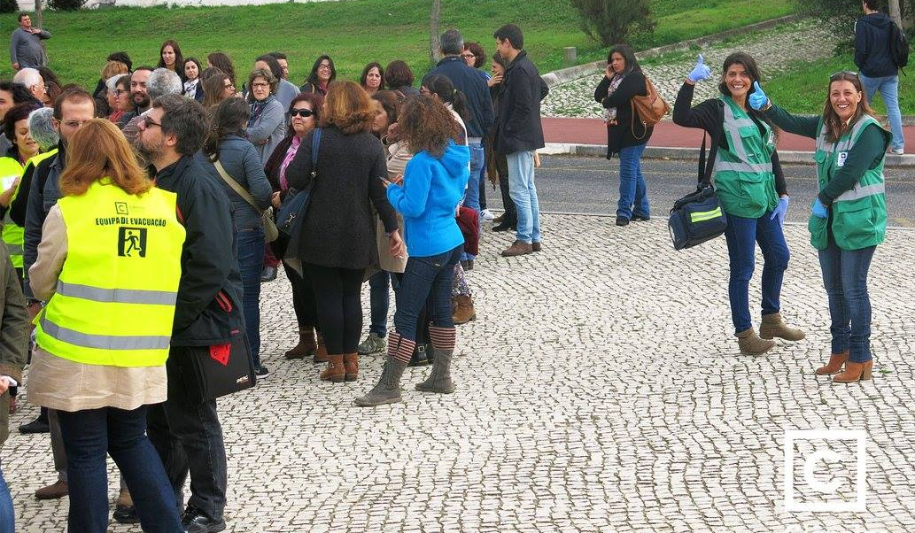
Welcome to Ciências and work...
... SAFELY!
... HEALTHY!
... BEING SUSTAINABLE!
www.ciencias.ulisboa.pt/g3s | g3s@ciencias.ulisboa.pt

