Slide 1
Research @ CIÊNCIAS
^{WELCOME SESSION}
²⁰²³

Slide 2



CIÊNCIAS support to research
PMO
https://ciencias.ulisboa.pt/pt/direcao-de-id
http://www.fciencias-id.pt/node/9
Project Management Office
Integrated in the Ciências R&D Unit
Team composed by a Coordinator and 3 Project Managers
Mission: Administrative and financial management of projects throughout their life-cycle, interacting with the Financial Resources and Assets Unit and the Human Resources Unit whenever necessary
- National Projects Office – national funding (e.g. FCT) nacionaisID@fciencias-id.pt
- International Projects Office – international funding (e.g. H2020) internacionaisID@fciencias-id.pt
-Research under Contract Office – privately funded services contratosID@fciencias-id.pt
-Pre-award Office – applications preparation candidaturasID@fciencias-id.pt
…and a shared Financial e Human Resources Office that deals with accounting, procurement and aquisitions, suppliers, contracts, scholarships …

Slide 3

FUNDING OVERVIEW: APPLICANT INSTITUTION
Public institution
Higher Education institution
Co-funding required from the applicant
Private non-profit institution
Research dedicated institution
Projects 100% funded by Funding Institution
Ciências PMO
FCiências.ID

Slide 4
CIÊNCIAS SUPPORT SERVICES TO RESEARCHERS
Pre-award
Application stage
Project Management
Project Closure

Slide 5
Pre-award
Application stage
Project Management
Project Closure
Contact the office
Search for calls /Presentation of WPs
Read the call for proposals supporting documents;
Proposal registration and submission;
Contact with the funding institution, consortium partners and national supporting offices
Proposal review (administrative);
Administrative support (budget, organization, template forms, documents signature, etc).

Slide 6
Pre-award
Application stage
Project Management
Project Closure
TIPS FOR PREPARING A WINNING PROPOSAL
First thing: Get in touch with the office!
Prepare your proposal well in advance
Financial matters are decided by the Board of the institutions
Official signatures take time
Proposals are a joint committment between Researchers, their R&D Unit and the Institution

Slide 7
Pre-award
Application stage
Project Management
Project Closure
Contract preparation
Contact with project officer and/or Consortium partners
Contract signature
Administrative and financial execution monitoring
Project purchases (specific rules for hiring Personnel and for acquisition of material, equipment and Travel)
Financial reporting

Slide 8
Pre-award
Application stage
Project Management
Project Closure
TIPS FOR A SUCCESSFUL PROJECT
First thing: Be aware of the institution procurement rules!
Equipments is acquired and registered in the institution’s accounts
Always dialogue with your consortium partners
Scientific matters are the reserachers’ responsability!
Always remember: your project manager is your best friend!

Slide 9
Pre-award
Application stage
Project Management
Project Closure
Final review meeting
Final reporting
Accounting closure
Audits
Taxes payment (Services contracts)
Assessment of the project’s success: what happens next?

Slide 10
Pre-award
Application stage
Project Management
Project Closure
TIPS FOR A SUCCESSFUL PROJECT CLOSURE
Well documented project
Up-to date documentation (financial documents, meeting minutes, deliverables)
Start preparing your next challenge: a new project? Go back to the tips for a successful proposal!

Slide 11
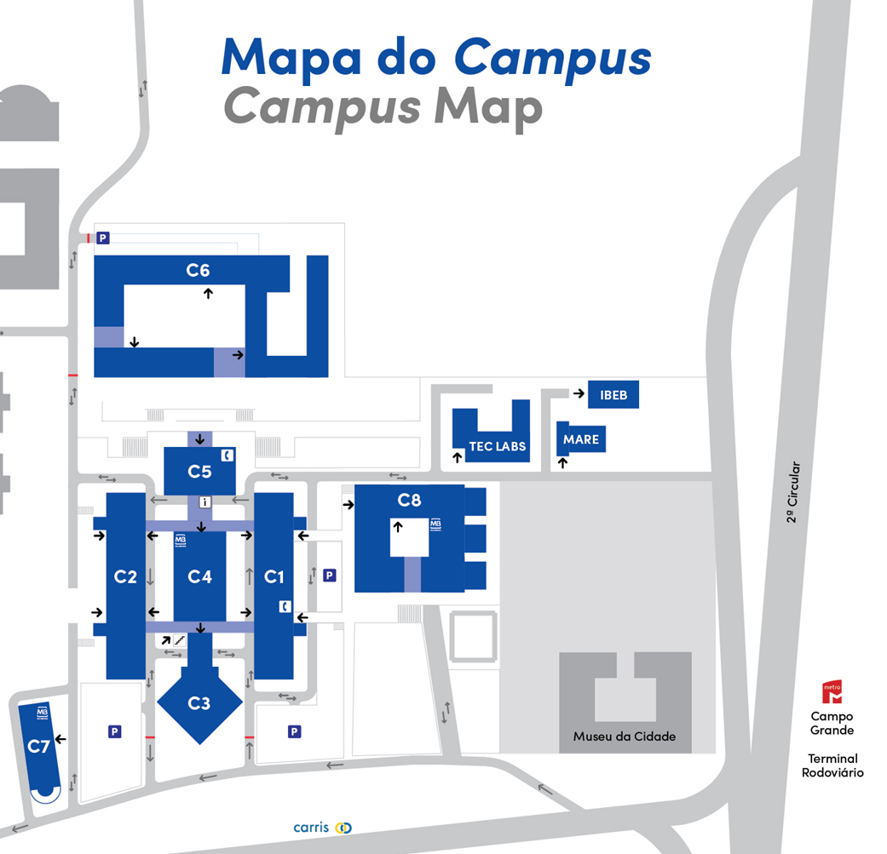
Where are we?
Ciências Project Management Office
Edifício C5, Piso 1
Email: areagp@fc.ul.pt
https://ciencias.ulisboa.pt/pt/direcao-investigacao-desenvolvimento#toc3
FCiências.ID
Edifício C1, Piso 3
Emails: fciencias.id@fciencias-id.pt
Many specific internal regulations and forms can be found at:
http://www.fciencias-id.pt/node/50 and here
http://www.fciencias-id.pt/node/32
PMO
FCiências.ID

Slide 12
THANK YOU!

