Slide 1
From Physics to Biomedical Engineering A Teaching Experience
Nuno Matela
Faculdade de Ciências da Universidade de Lisboa
Departamento de Física
Instituto de Biofísica e Engenharia Biomédica

Slide 2
Timeline
Bachelor in Technological Physics Engineering (1996-2002)
PhD in Biomedical Engineering and Biophysics (2002-2008)
Coordinator of the PhD in Biomedical Engineering and Biophysics (2018-2023)
1996
2002
2008
2018
2023
2011
2016
2000
2013
2022
2003
Adjunct – Coordinator Professor
Radiology, Pharmacy, Clinical Analysis
(2003-2013)
Invited Assistant Professor
Biomedical Engineering
(2011-2016)
Assistant Professor
Biomedical Engineering
(Since 2016)
Member of the Pedagogical Council (since 2022)
Member of the Ethics Committee (since 2022)
Coordinator of the BachelorD in Biomedical Engineering and Biophysics (since 2023)
Practical Classes Assistant
Physics
(2000-2003)

Slide 3
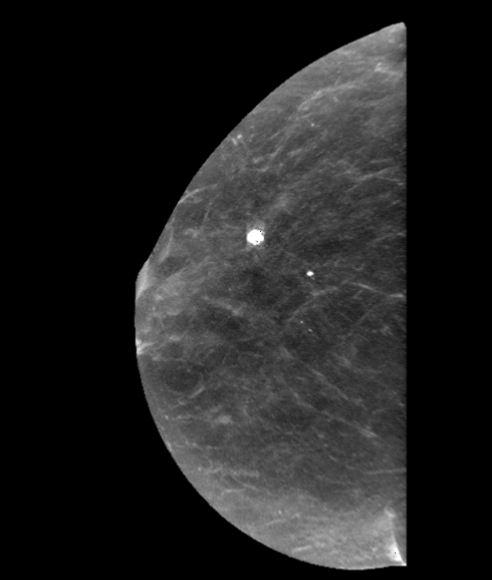
Other Scientific / Academic Activities
Researcher at Instituto de Biofísica e Engenharia Biomédica
Main Topics of Research:
Medical Imaging
Cancer Diagnosis
Medical Devices
Theses supervision and co-supervision:
7 PhD Theses (6 ongoing)
104 Master Theses (18 ongoing)
Member of Rede Saúde from ULisboa
Member of the Working Group Innovation & Knowledge Transfer
Member of the National Cancer Hub
Member of the Working Group Diagnosis and Treatment

Slide 4
Teaching Experience
The first time I entered a classroom as a teacher I was 20 years old
There were not enough seats for all the students
Many of the students were older than me
Had no pedagogical preparation
Had a list of exercises to solve during the class, but no solutions
At least I had older colleagues who had taught those classes in the years before to ask for hints

Slide 5
Teaching Experience
Three years later I was hired to create three new courses for a recently created degree
Analyse how reference books are organized
Discuss with teachers who will teach students in subsequent years and with future employers to understand what they expect students to know
Look around and see how other colleges are teaching these subjects
Always discuss the syllabus with the degree coordinator
Avoid overloading students with too much content and too much work *
Workload estimators:
https://cat.wfu.edu/resources/workload2/
https://ubcoapps.elearning.ubc.ca/time-estimator/

Slide 6
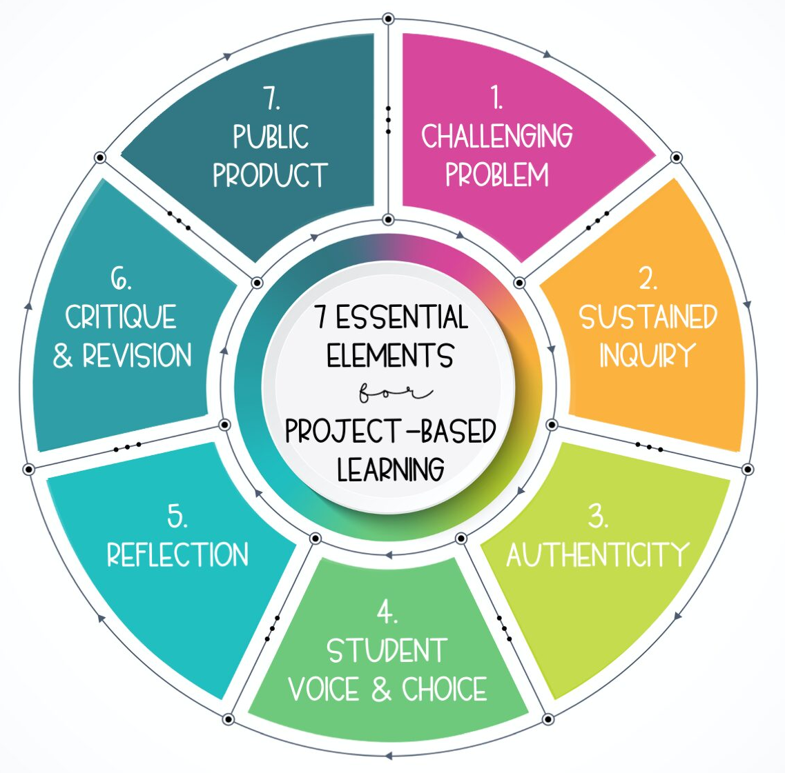
Teaching Experience
Currently:
Courses in the first year of the Bachelor in Biomedical Engineering and Biophysics
Courses in the first year of the Master in Biomedical Engineering and Biophysics
Solutions (all inherited from the previous teachers) that have been working well:
Much of the evaluation is continuous evaluation (projects, reports, essays)
Let the students define the topics and goals of their projects/theses
Discuss with your colleagues the possibility of having different parts of the same project being developed in different courses
Encourage the students to continue with the project after the course is finished

Slide 7
Closing Remarks
Take advantage of all the pedagogical training actions provided
Read carefully all the comments in the pedagogical surveys
Consider making your own surveys during or at the end of the course
Don’t be afraid of trying different evaluation strategies
A quiz like a bar quiz may replace a written test
Try to call your students by their names
Remember that a single class may have a big impact on the future choices of your students
Be available for your students. The students are the reason we were hired

Slide 8
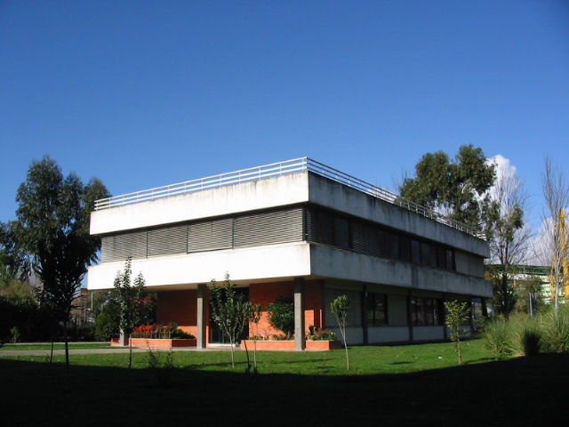
Thank you for your attention
nmatela@fc.ul.pt
Ext 520505

