Slide 1



CIÊNCIAS support to research
PMO
CIÊNCIAS can delegate the execution of certain tasks to private law entities, namely the management and promotion of R&D activities.
FCiências.ID, is a Non-Profit Private Association, created to support, potentiate and develop Research and Development activities of its associates
CIÊNCIAS and FCiências.ID jointly manage the CIÊNCIAS research centres and projects, simultaneously enhancing CIÊNCIAS strategic partnerships with market and services companies, therefore creating a more challenging environment for research and innovation.

Slide 2

FCiências.ID
Interaction between FCiências.ID and FCUL
Finantial flows: FCiências.ID → FCUL (R&D projects’ hosting costs, explicit in the yearly audited reports)
No management interference
Opperational interference: facilities, security and safety, IT infrastructure
Harmonization and opperational support: whenever required, if affordable
FCiências.ID in a nutshell
Non-Profit Private Association: FCUL + 6 private companies
Public Utility recognition (1/2022)
Managing R&D projects since 1995
Binding law: Labour Code, law 57/2017, Public Procurement (CCP) (majority of public funding for R&D), Science Law, VAT, IRC, ...
Transparency: annual management and financial reports, activity plans, operational regulations, ...
~250 fellows + ~150 researchers + ~50 employees
Yearly financial execution (2022): ~15 M€
Modus vivendi
Complete contractual liability to R&D funders
Self-funding through R&D project overheads (25%, 12%)
Organized accounting rules, permanent external audit
Finantial solidarity among researchers / R&D units
Culture of continuous improvement and proximity to researchers
Conservative / preventive action / no litigance
Does not spend unavailable money and does not create bank debts

Slide 3
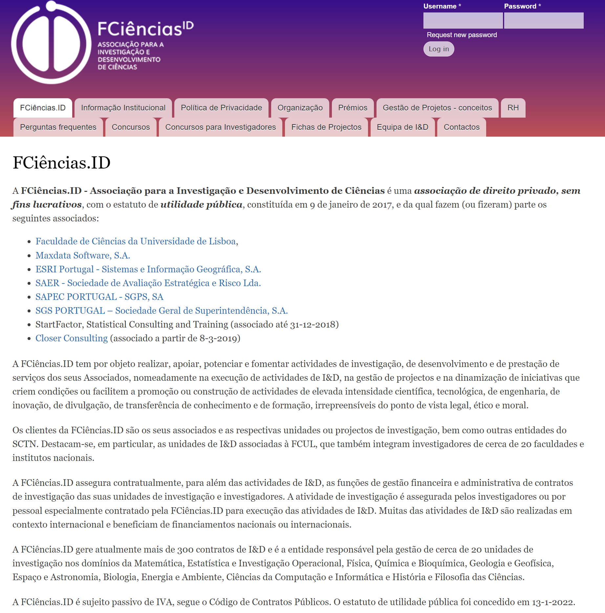
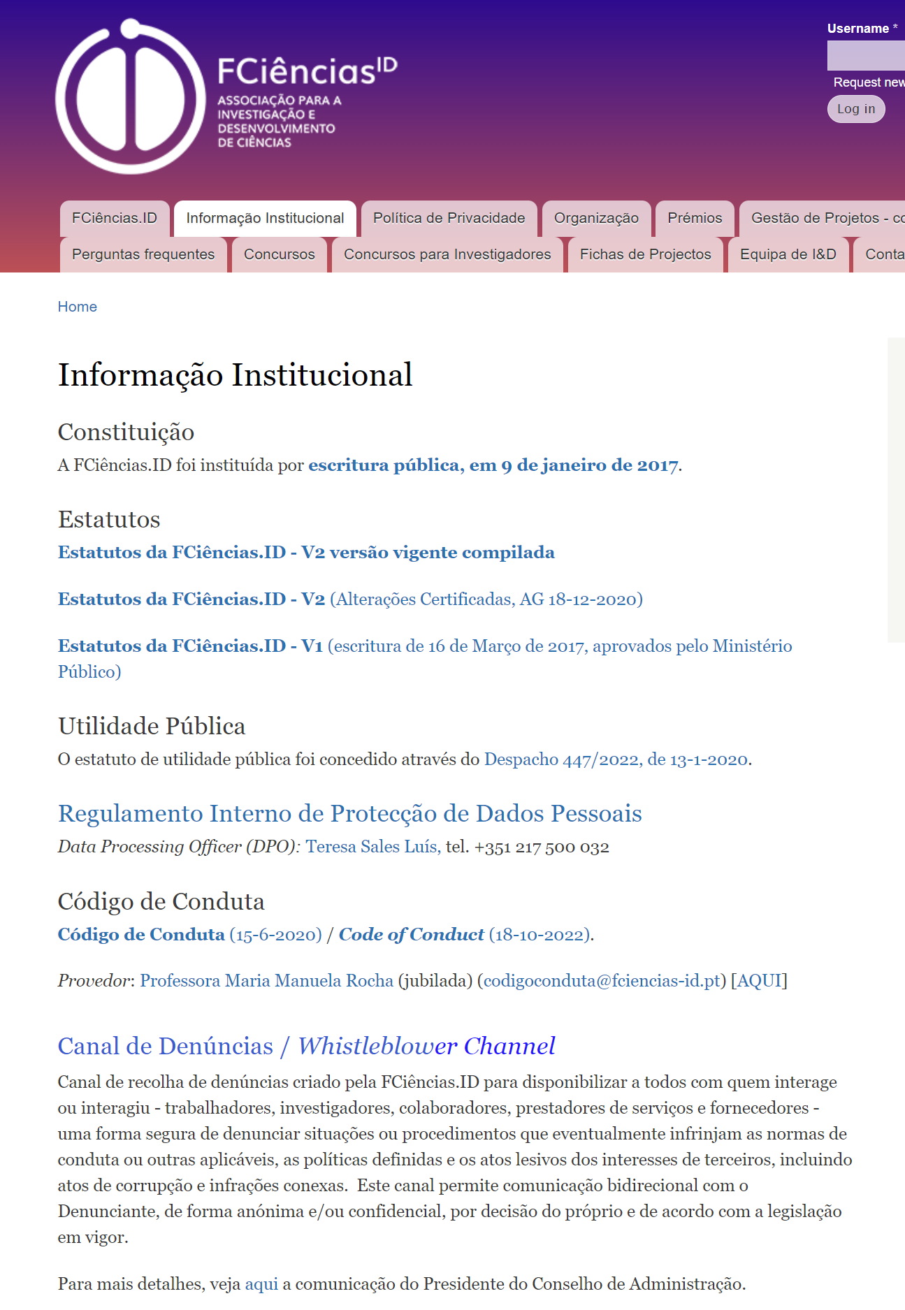
FCiências.ID

Slide 4
FCiências.ID

Slide 5
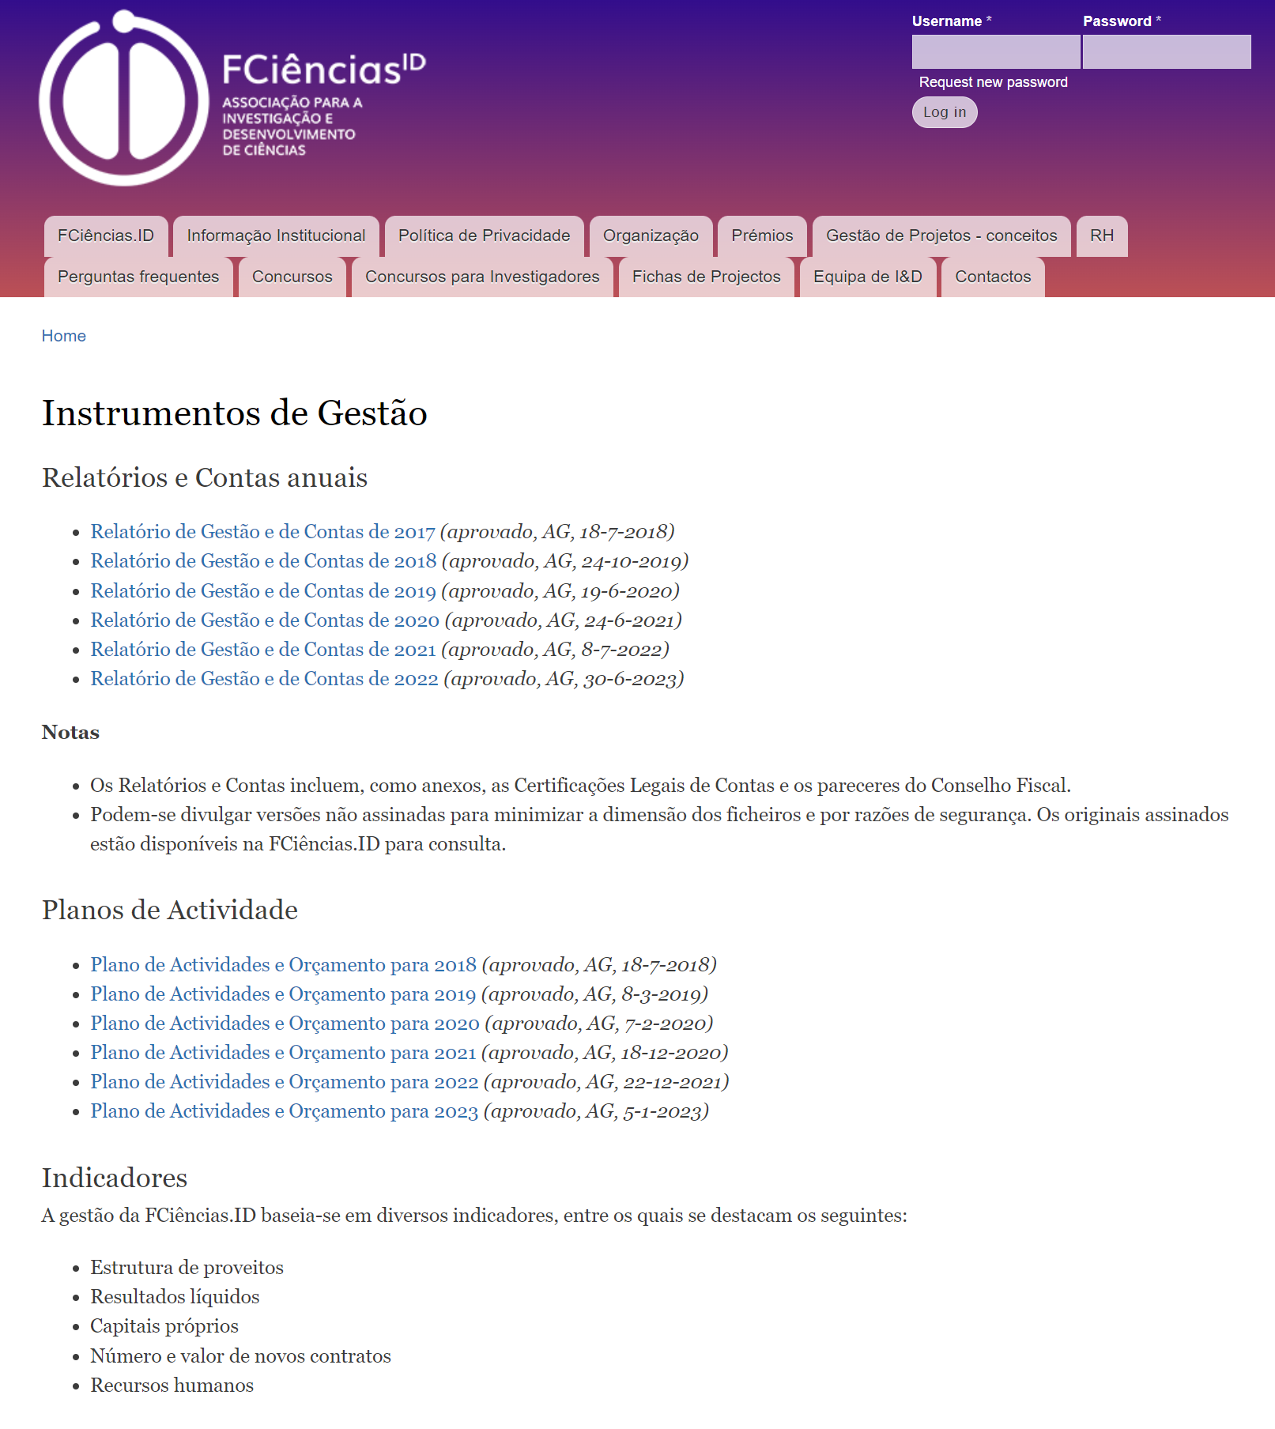
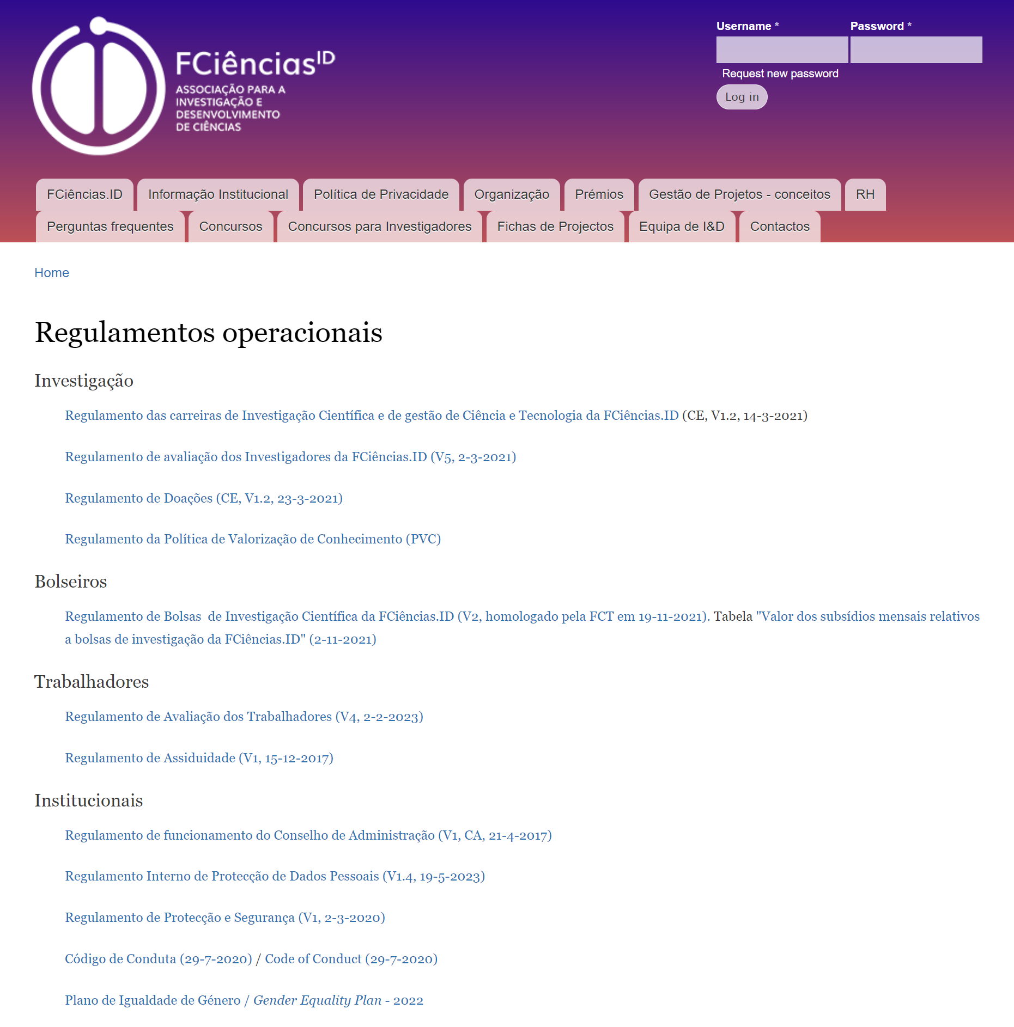
FCiências.ID

